Slide 1



Health eTime Solution for the VA 21st Century Medical Scheduling Contest
CalConnect
Conference Workshop
May 21, 2014
600 New Hampshire Ave. NW #610 Washington, DC 20037 | T: 202.333.3506 | www.medred.com

Slide 2

Background
The VA 21st Century Medical Scheduling Contest was announced on Challenge.gov in early 2013
On 13 June 2013, the MedRed, BT Team submitted the Health eTime scheduling application, a rapid prototype designed to specifically address the VA scheduling requirements as reflected in the contest guidelines
In Oct. 2013, based on Step 1 and 2 evaluation criteria, Health eTime was judged by VA evaluators to be the first place winner of the contest

Slide 3
Purpose
To describe the process and outcome of the VA 21st Century Medical Scheduling Contest
To present an overview of the Health eTime contest submission and lessons learned from the contest to the CalConnect community
To encourage workshop participants to dialogue on scheduling standards and support the VA community in ongoing efforts to deploy and support a solution

Slide 4

About MedRed
Established in 2004, MedRed, LLC is an industry leader in the development of dynamic data capture, decision support, patient scheduling, and analytics solutions that utilize Smart Forms and web-based technologies to provide a comprehensive patient management system.
Since 2007, MedRed has been working under contract to develop and implement point-of-care data capture and decision support tools aimed at improving diagnosis, treatment, and outcomes for Polytrauma patients at a number of Department of Defense and Veterans Affairs medical centers.
Internationally, MedRed’s software solutions are being utilized by the Field Epidemiology Laboratory Program Alumni Association (FELP-AA) and the Kenyan Ministry of Public Health as part of a coordinated effort to assist in disease outbreak surveillance, response and management

Slide 5
About BT
BT is a global service communications and IT service provider. Founded in 1846, the company has a presence in over 170 countries and over 89,000 employees worldwide. For the year ended 31 March 2013, BT Group’s reported revenue was £18,103m with reported profit before taxation of £2,315m.
In the US and Canada BT has over 3,000 employees serving more than 1,000 customers, including 73 per cent of Fortune 500 and 48 per cent of Fortune 1,000 companies.
BT supports various Healthcare customers globally including the English NHS. Services for the NHS include implementing and operating the dedicated, national broadband network; a national EHR and set of supporting services; and clinical IT services for hospitals across London and the South of England.
BT’s experience in healthcare goes back 60 years to the formation of the NHS. BT has been a trusted partner of the NHS, and has participated in virtually every major IT and communications infrastructure project since that time.
British Telecommunications plc (BT) is a wholly-owned subsidiary of BT Group plc and encompasses virtually all businesses and assets of the BT Group. BT Group plc is listed on stock exchanges in London and New York.
For more information, visit www.btplc.com

Slide 6
VA Scheduling Contest Framework
Up to $3M in prize money per winner, and up to three winners for a total of $9M in potential award
Contestant scheduling solution must be loaded on to three Virtual Machines (VMs) furnished by VA and representing California, Georgia, and Alabama VistA instances
Contestant also had to load the User Manual and Requirements Traceability Matrix on the VMs

Slide 7
VA Scheduling Contest Framework
VMs were locked down on 13 June 13 for VA Step 1 and Step 2 Evaluations
Step 1 Evaluation: Contestant solutions were executed against eight VA defined Use Cases via contestant provided python test scripts that satisfied use case check points
Step 2 Evaluation: Contestant solutions demonstrated live to VA evaluators against 13 Scenarios and 87 Metrics that mapped to Step 2A Pass / Fail Business Need Metrics, VA Specific Requirements with points, and Non-functional Requirements (Functionality, Usability, Maintainability)
Step 2 Evaluation: In Step 2B, contestant solutions also gets points for Open Source

Slide 8
Primary Goals for Rapid Prototype
Provide Scheduling Capabilities Across VistA Instances and time zones
Fix Data Model to allow clinic capacity to map to individual providers
Introduce Standards-Based Scheduling- iCal

Slide 9
Primary Goals for Rapid Prototype
Cover the Use Cases
USE CASE 1: Establish, Organize, and Manage the Scheduling Component
USE CASE 2: Establish and Manage Section Schedules
USE CASE 3: Create a Patient Appointment
USE CASE 4: Manage a Patient Appointment
USE CASE 5: Manage a Walk-in Patient
USE CASE 6: Cancel Individual Appointment
USE CASE 7: Reschedule Individual Appointment
USE CASE 8: Add Appointment Request to Waiting List and Schedule Patient from Waiting List

Slide 10
Development Principles
Open Source
Maintain Integrity & Functionality of Legacy Systems
Tiered Architecture
Modularity
Service-Oriented Design
Database Independent
Leverage Standards
Cover as many requirements as possible

Slide 11
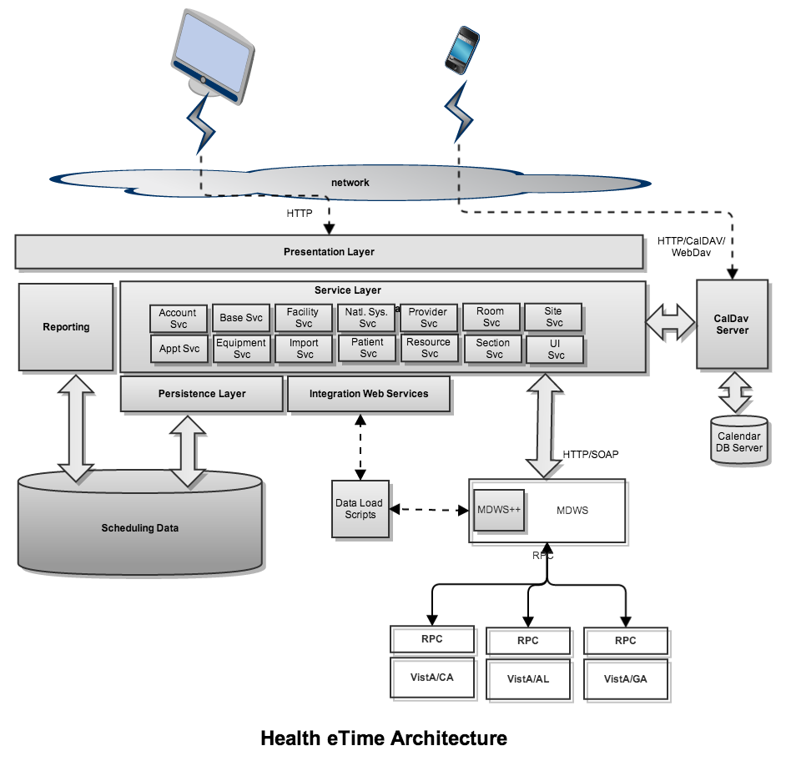
Web-based Solution Architecture
C#, .Net, jQuery, CSS, DayPilot
C#, .Net,
WebDav.net,
Log4Net
SQL Server Reporting Suite
HTTPS
nHibernate
Bedeworks
MS SQL Server
Python
MDWS

Slide 12
Health eTime Capabilities
VistA Integration Requirements
Synchronize organization info (Top Level Management Sys. Facilities linked to the Top Level Management Sys.)
Synchronize reference data (Apt. Type Cat., Cancellation Reasons, List of Services Types, Stop Codes)
Synchronize resource data (Providers, Room, Equipment)
Pull patient demographics information at time of Appointment (SCPercent, IsVeteran, ServiceConnected, ActiveInsurance, PatientType, NeedsMeansTest)
Push Appointment info into VistA Appt Master Data Record (New appointments, Check-ins, Check-outs, Cancellations)

Slide 13
Health eTime Capabilities
VA Unique Scheduling Requirements
VA enterprise wide schedule (sites, facilities, clinics)
Clinic capacity at each facility (appointment types, assigned resources, available times, etc.)
Creation of appointment slots for VA appointment types
Create telehealth appointments (coordinated across time zones)
Manage an electronic waitlist (new registration, enrollment, or consult request)
Track wait time metrics
Schedule appointments for one patient at different facilities
Reports on patient patterns, scheduling effectiveness, and resource utilization
Create summary reports for clinics, facilities, sites, and by VA VISN’s

Slide 14
Health eTime Capabilities Based on Contest Requirements (cont.)
Industry Standard Scheduling Requirements
User identity management (sys admin, scheduler, master scheduler, etc.)
User access control and security (adjustable access privileges based on user type)
Control of double booking privileges (Overbook)
Schedule integration (linking and transferring appointments across facilities)
Display patient cancellation, no-show, and walk-in history
Make linked appointments (can be between encounter and ancillary services)
Schedule recurring appointments automatically

Slide 15
Health eTime Capabilities Based on Contest Requirements (cont.)
Industry Standard Scheduling Requirements
Make walk-in appointments
Schedule group appointments
Appointment request handling for new, changed, or cancelled appointments (tracked in central database)
Ability to view patient’s current appointments , history, and appointment requests

Slide 16
Health eTime Capabilities Based on Contest Requirements (cont.)
Industry Standard Scheduling Requirements
Enable user to view provider, clinic, and resource scheduled appointments and availability
Create automatic notifications ability for both providers and patients (for appointment status)
Track check-ins, no-shows, and appointment completion
Create ability for users to create resource scheduling policy and set schedule blocks

Slide 17
Limitations
Due to time limitations not all contest requirements were met.
Use case scenarios provided the initial focus for the rapid prototype. User experience and industry standards were designated as a focus of future development.

Slide 18
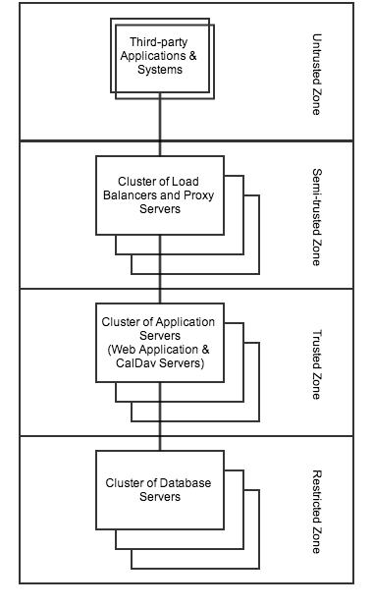
Scaling: Prototype to Deployment
Solutions architecture is tiered to allow both the horizontal and vertical scaling of each segment of the application.
Vertical scaling is accomplished by simply using larger machines within each tier
Horizontal scaling is accomplished by the separate clustering of each tier

Slide 19
Scheduling Contest Results
Health eTime test scripts ran flawlessly against the use cases in the contest environment in Step 1
The MedRed BT Team presented Health eTime to VA evaluators for Step 2 on 23 July 13
Full day of live demonstrations of use case scenarios

Slide 20
Scheduling Contest Results
In October, 2013:
MedRed and BT were awarded $1.825M for First Place
Oroville Hospital was awarded $0.705M for second place and
HP and partners were awarded $0.520M for third place

Slide 21
Scheduling Contest Experience
Suggestions:
A better understanding of process, goals and evaluation criteria would help efficient development and presentation planning
Providing broader latitude to industry around a set of objectives may produce more interesting and helpful contributions than a highly prescriptive SOW.
Transparency in regard to award allocation and enthusiastic communication of contest outcomes encourages companies to continue to invest at risk in future contests

Slide 22
Scheduling Contest Experience
Rare opportunity for small businesses to demonstrate agility, innovation, and responsiveness to user requirements
Proposed size of contest award drew substantial participation by broad spectrum of companies operating at risk.
Contest challenge encouraged new and innovative corporate partnerships and a variety of approaches to the solution

Slide 23
Scheduling Application
Video Demonstration

